Slide 1

Esteban Garcia, Ph.D.
Department of Computer Graphics Technology
Faculty Fellow – Purdue Polytechnic Institute
garcia0@purdue.edu
Notes:
First I would like to ask. Have you heard about the polytechnic? Take comments

Slide 2
whole person
cooperation
openness
diversity
autonomy
collaboration
access
empathy
risk taking
Notes:
First I would like to ask. Have you heard about the polytechnic? Take comments.

Slide 3
Notes:
I am going to explain our process- please stop me whenever you need

Slide 9
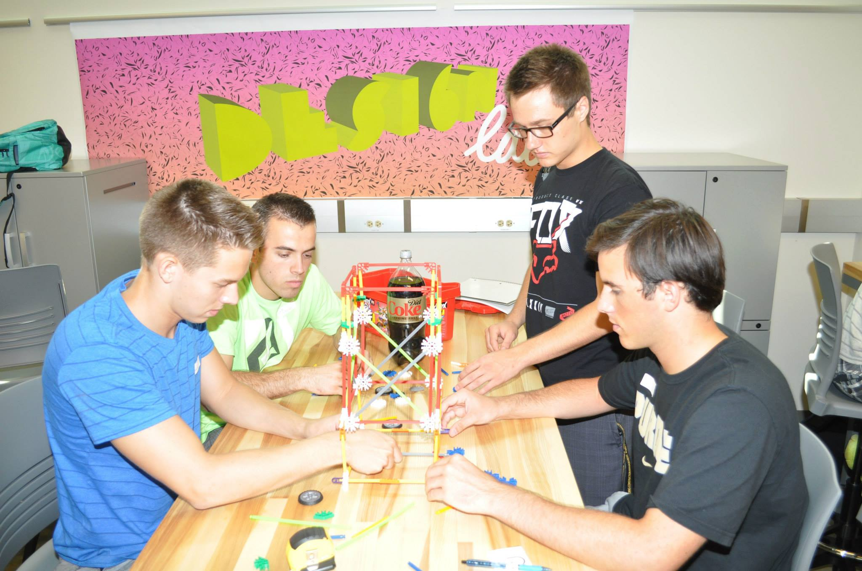
Design Lab
Notes:
In this activity, students collaborate in creating a structure that can lift a coke bottle.
**We made it really easy fro the freshman students this year by using a diet coke bottle. Everybody knows that diet coke is lighter than regular coke

Slide 13
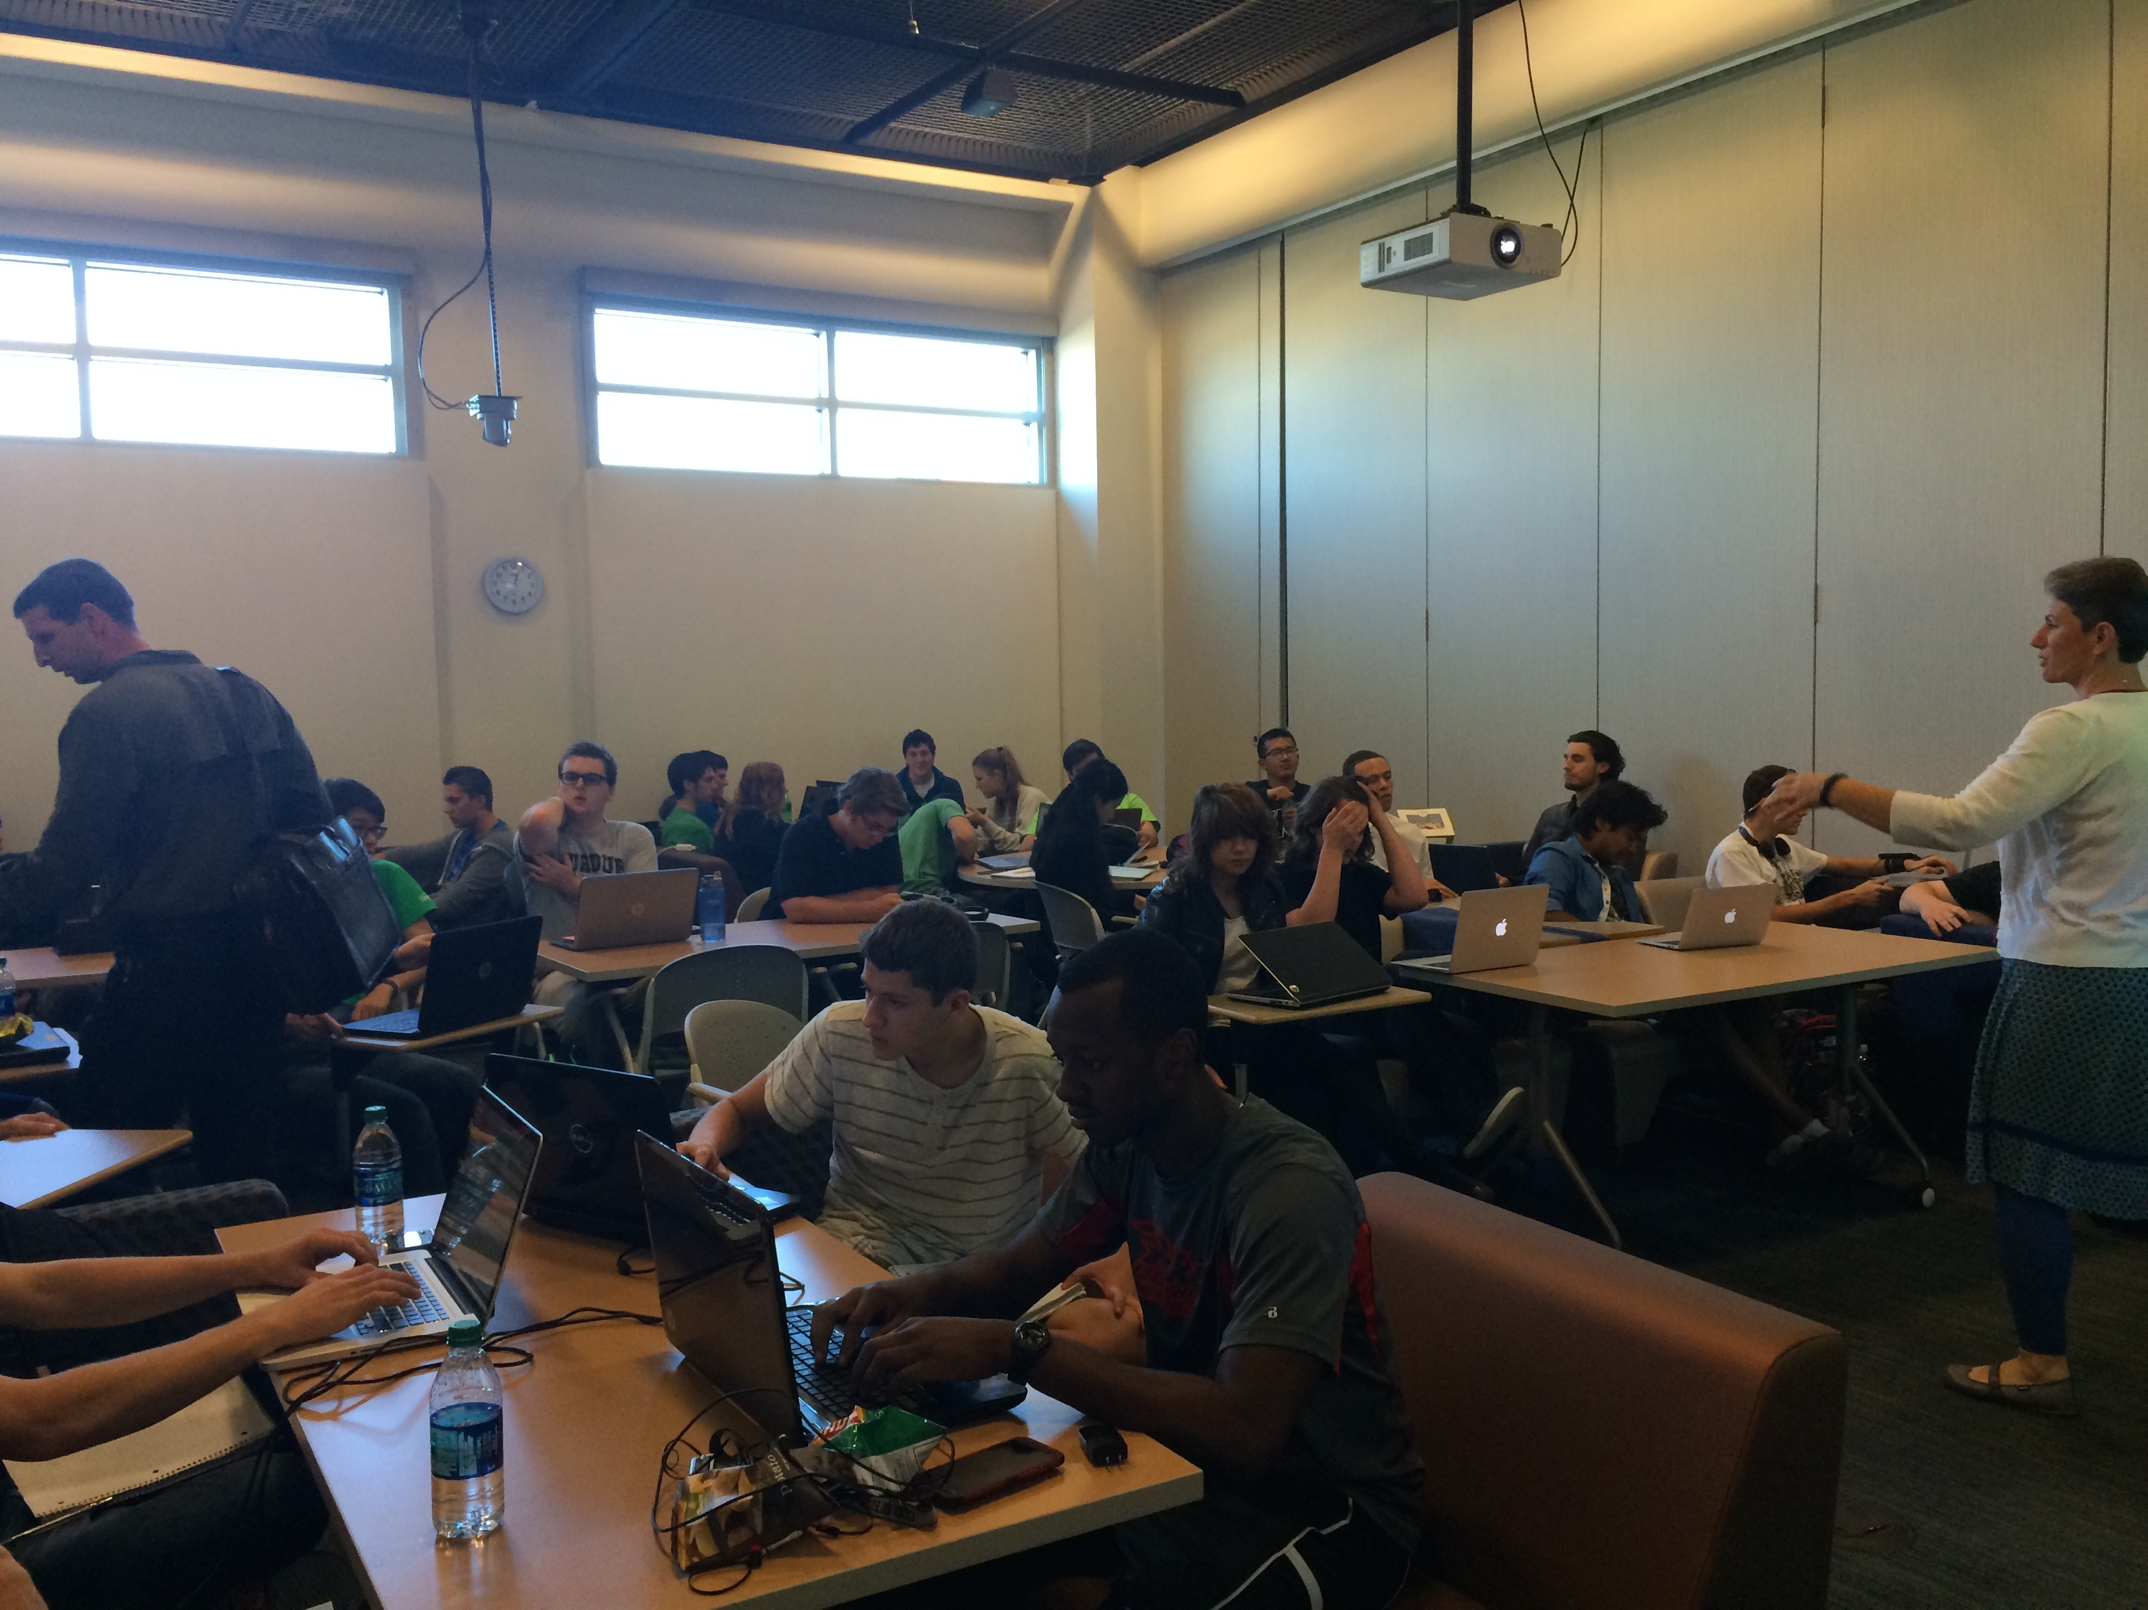
Seminar

Slide 15
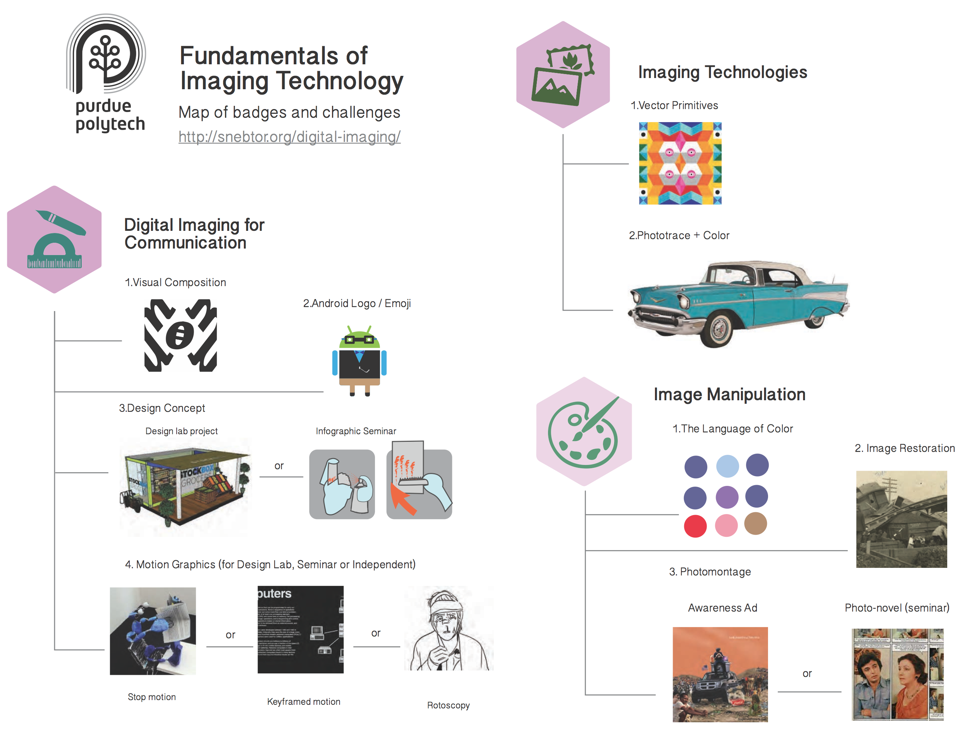

Slide 16
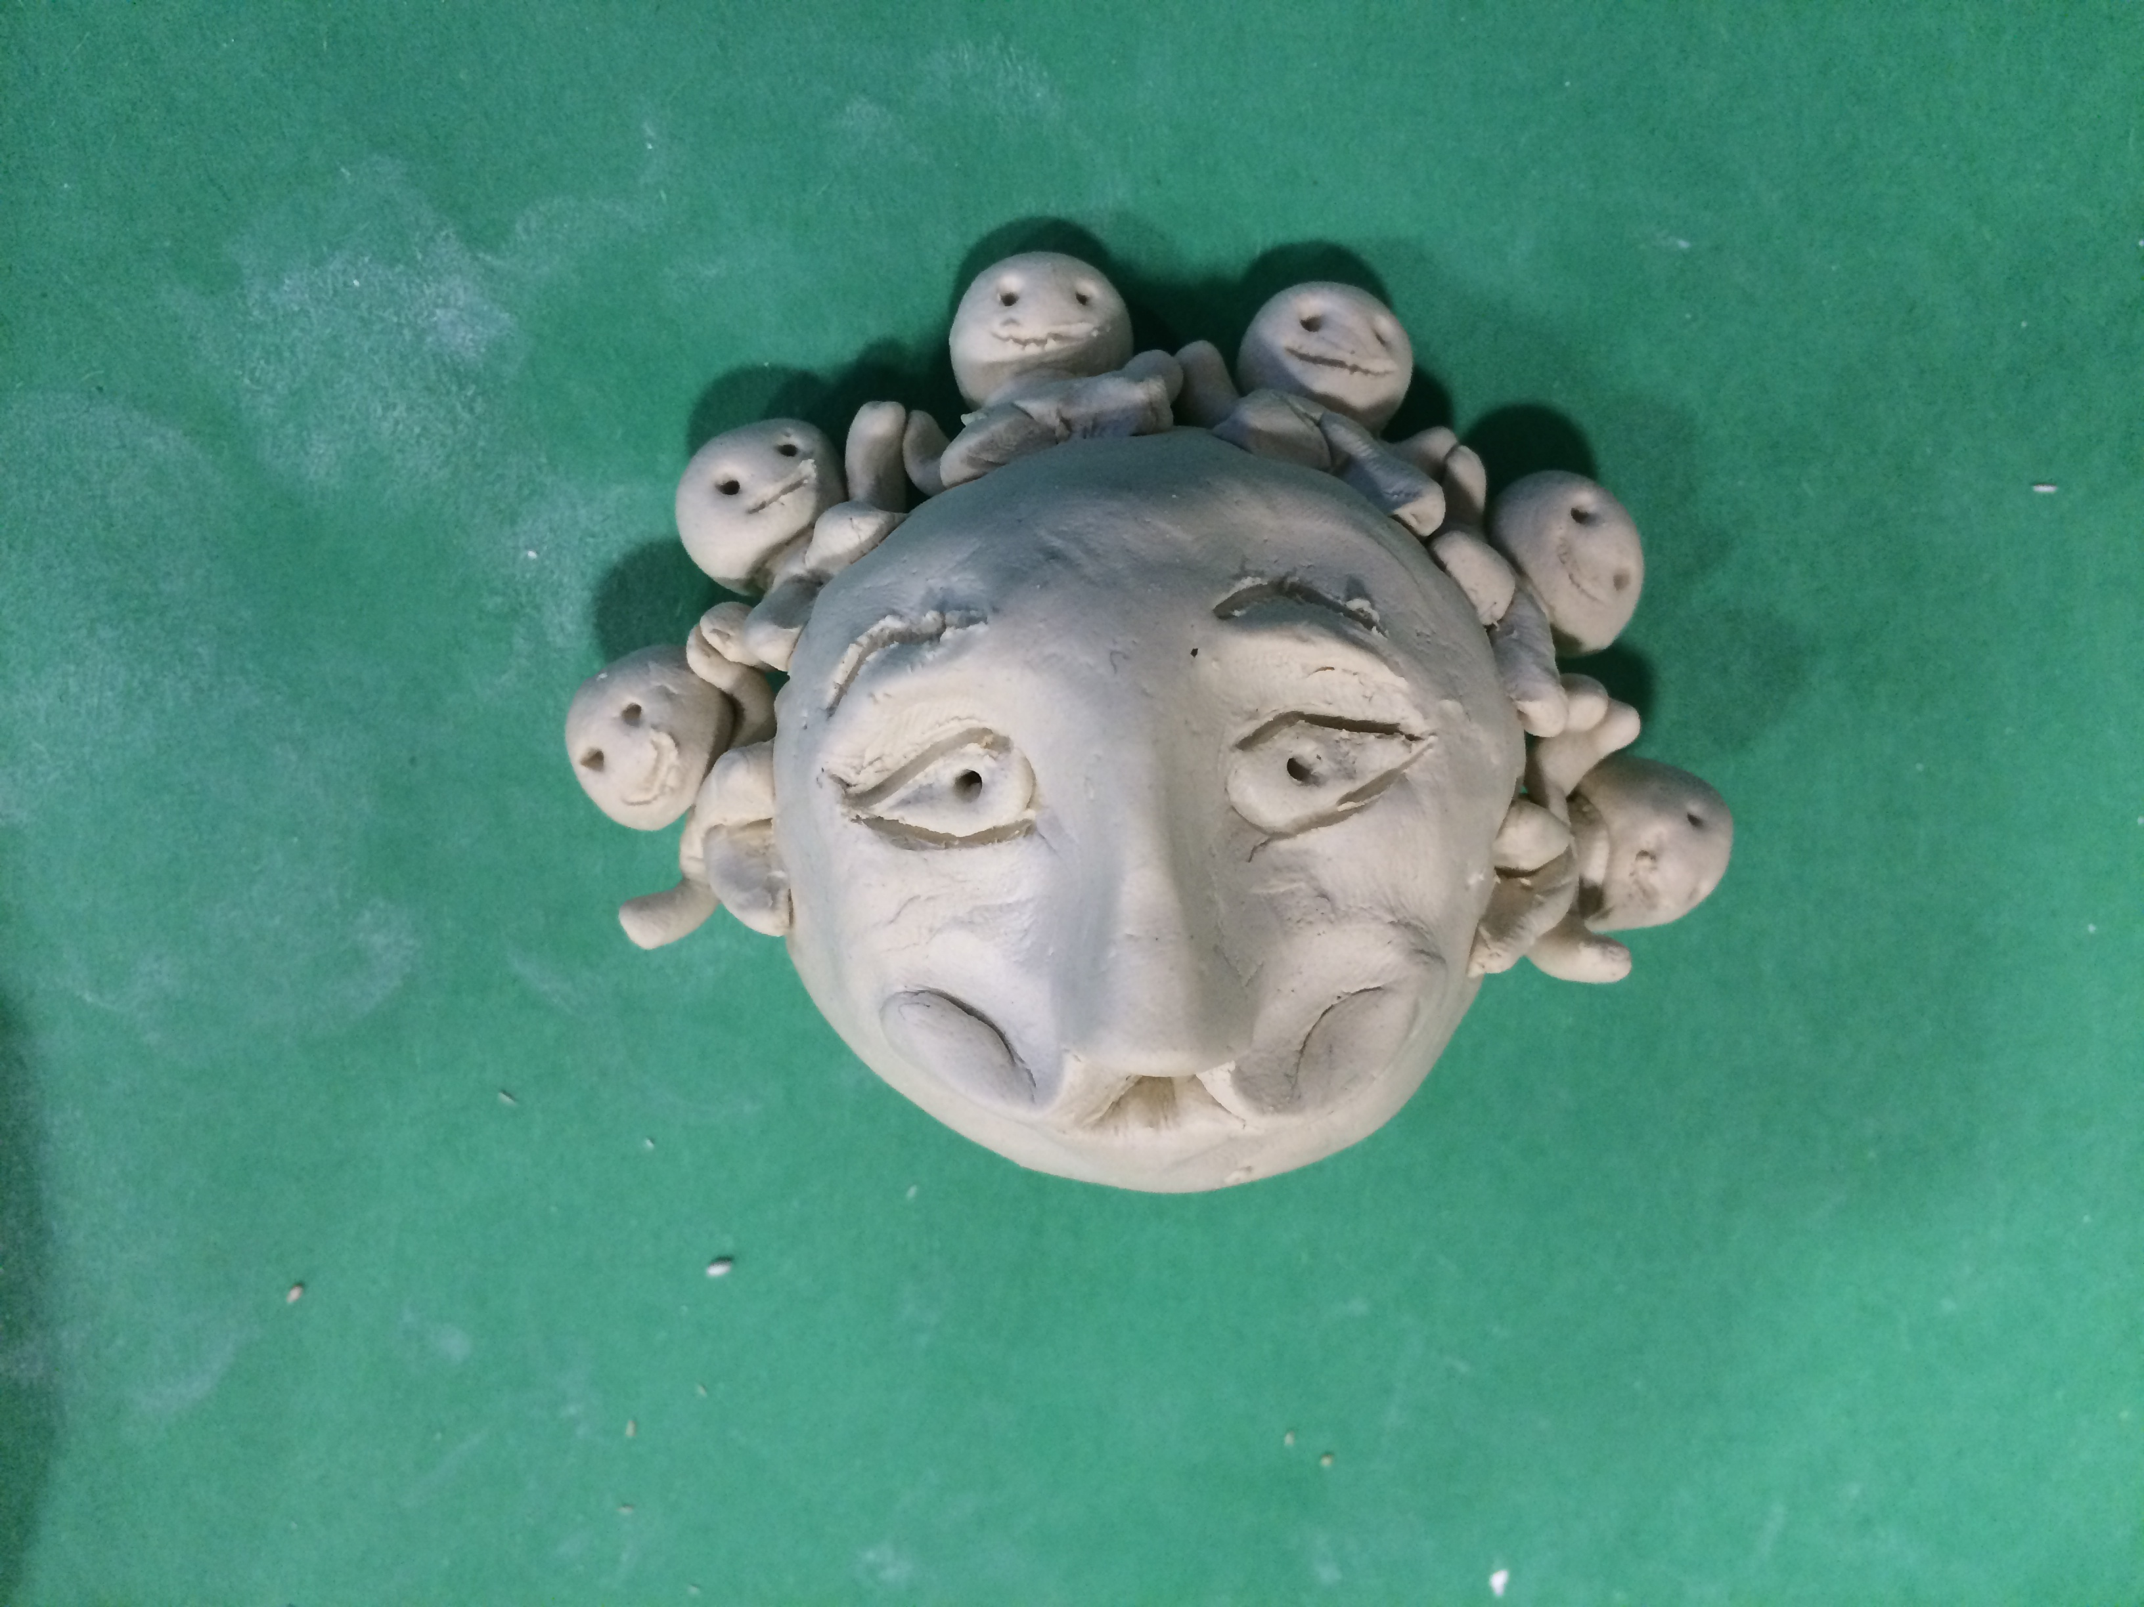
Culture, Communication, and Digital Narratives
“Seminar”
Storytelling as a way of thinking:
How can artistic storytelling help you learn, create and communicate?
WHAT IS YOUR STORY?
Notes:
Students learn to identify problems, and areas of interest, refine their interests, seek and find information, critically analyze sources and most importantly communicate this information for communication in the XXI century

Slide 17
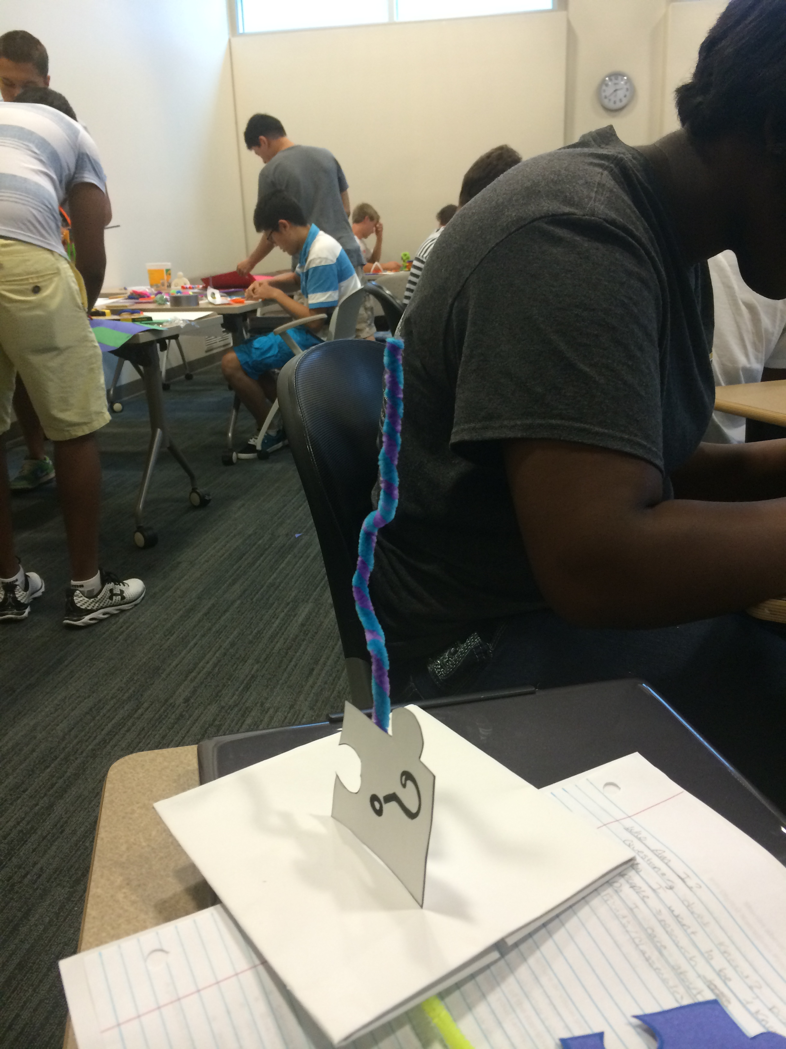
Notes:
Before I move on, Questions up to this point? All right, let’s do our first challenge!

Slide 18
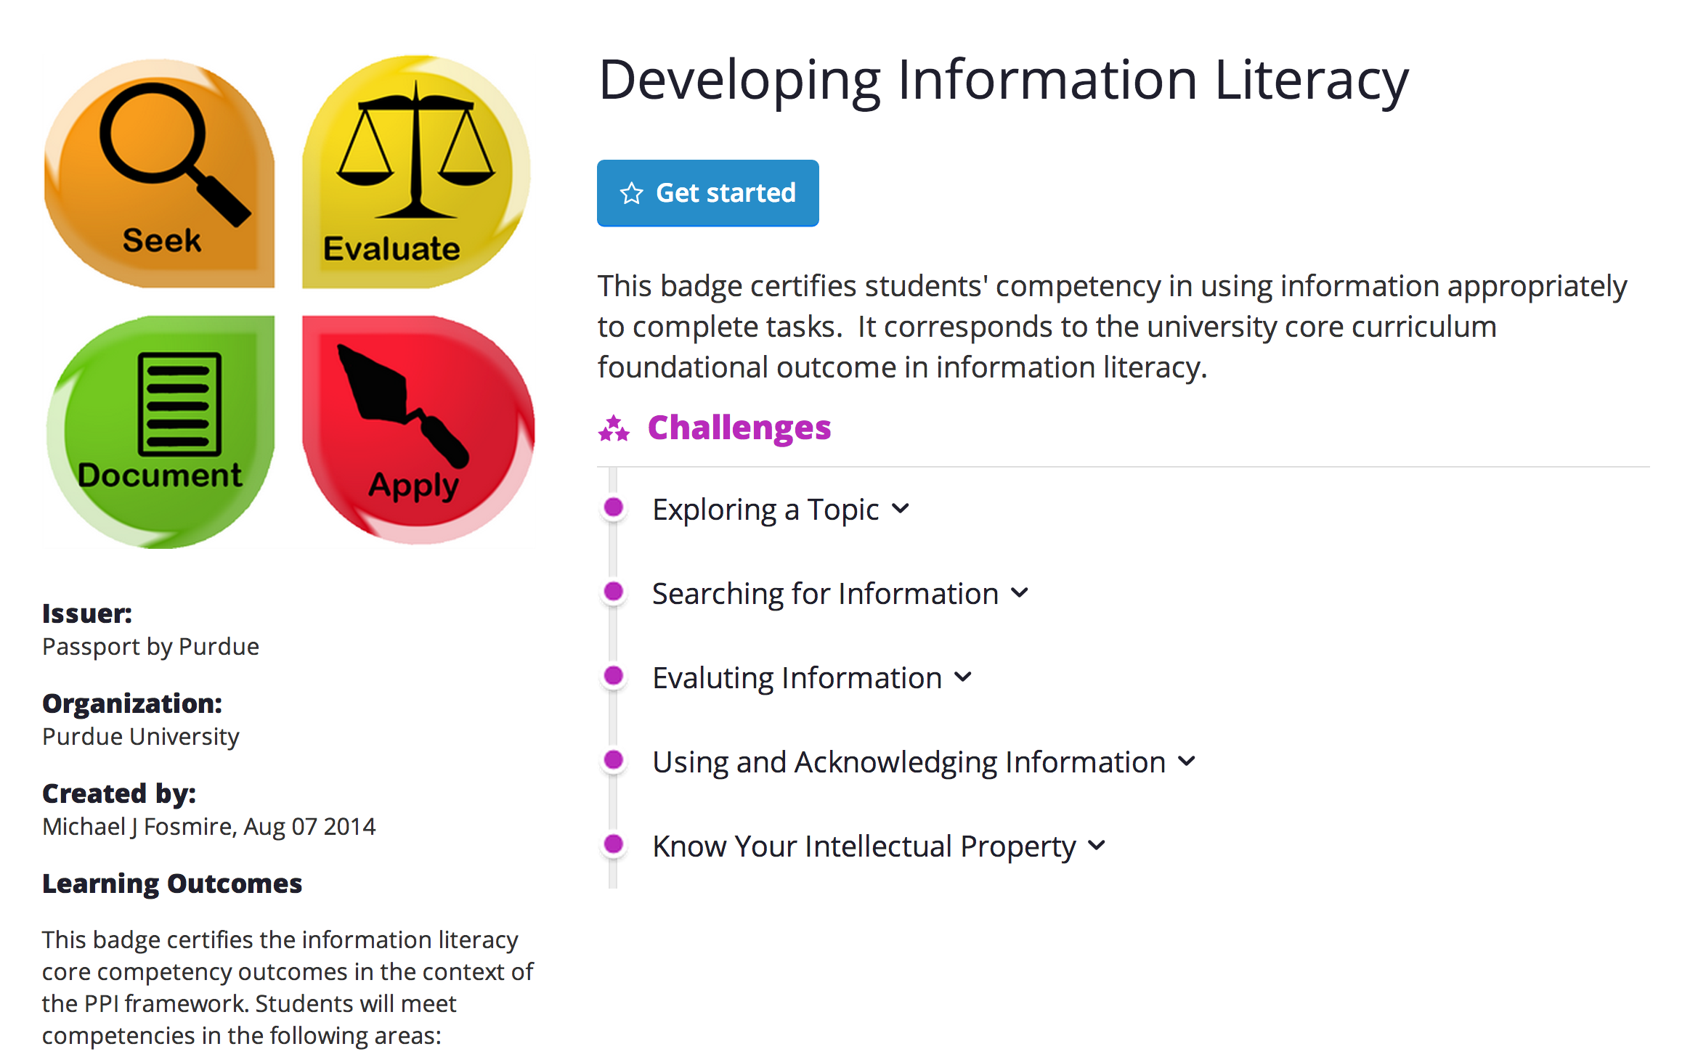
Notes:
As explained before, we want to be able to identify problems, areas of interest and sources. This project is taken from our seminar experience and it is very helpful to systematically organize the process of information seeking and gathering. (it is very useful for all kinds of tasks in life)

Slide 19
